Slide 1
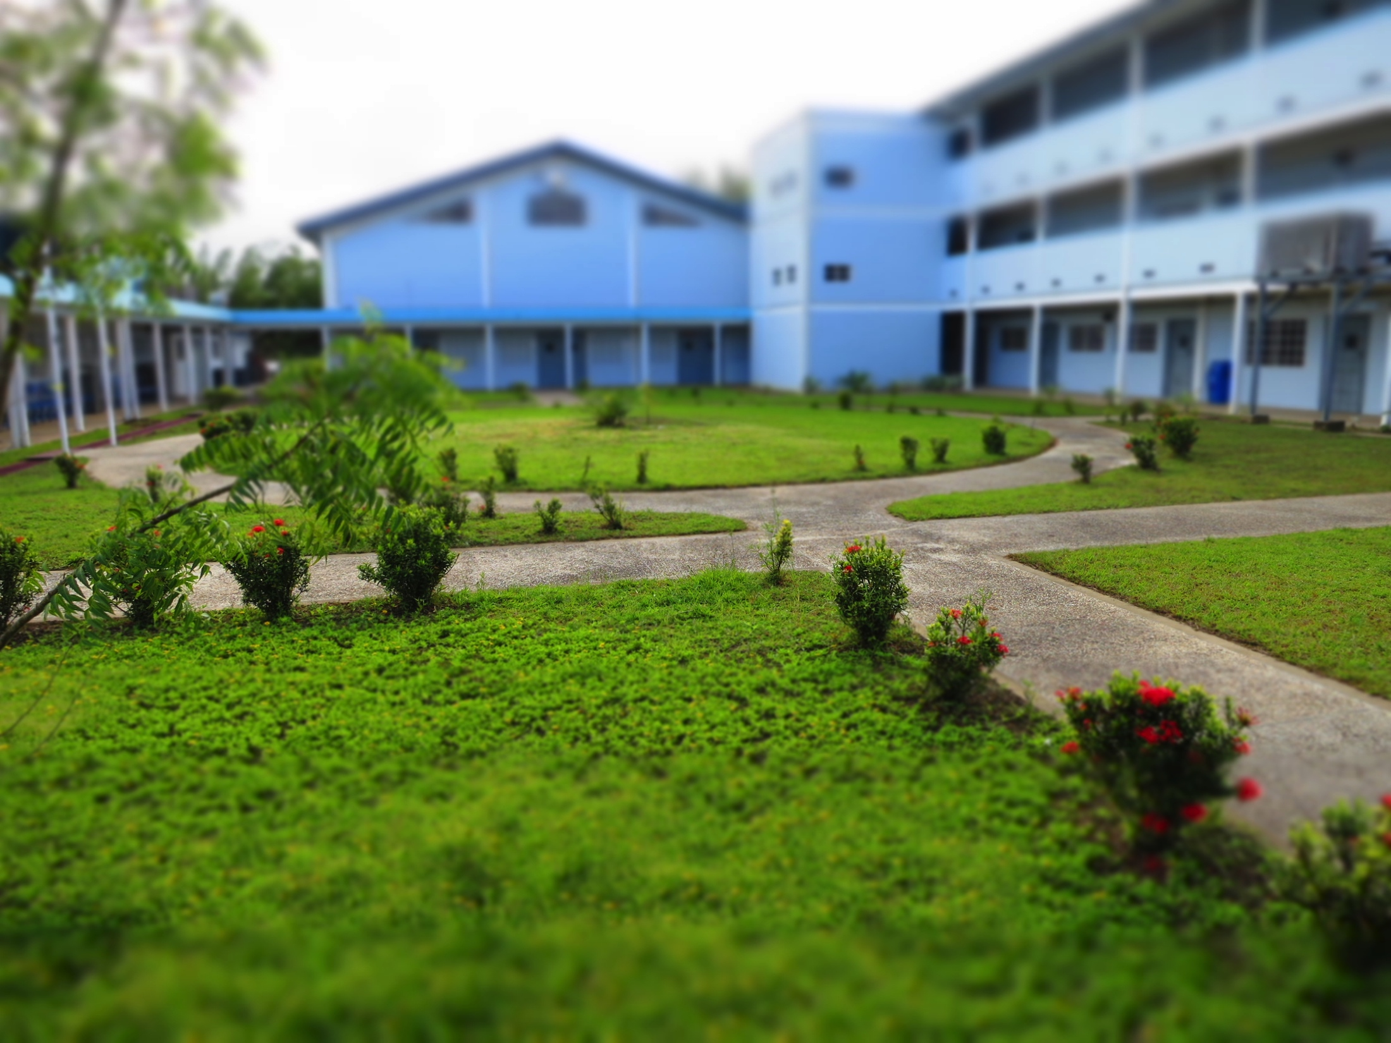
9645
TTCSI “I AM” SECONDARY SCHOOLS COMPETITION CHALLENGE

Slide 2
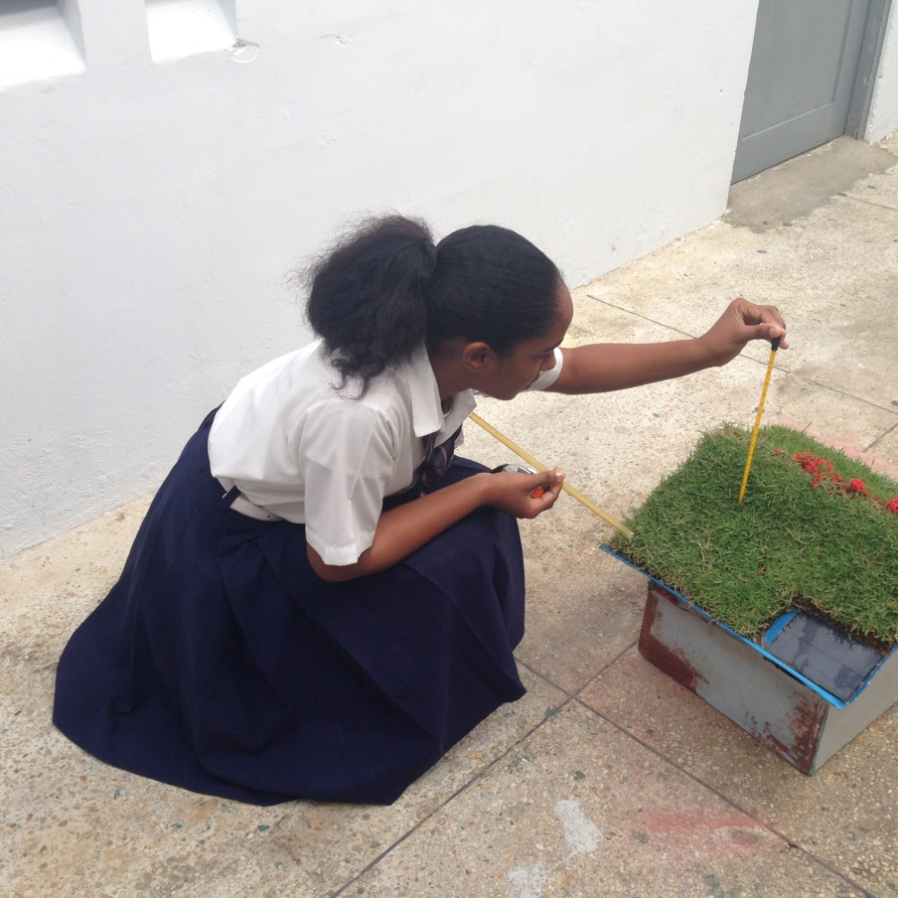
PROJECT
TO EFFECTIVELY LOWER THE TEMPERATURE OF THE EXISTING SCHOOL’S AUDITORIUM USING A GREEN ROOF

Slide 3
INTRODUCTION
Our school consists of approximately 520 students who rely on the use of the auditorium for extra curricular and co-curricular activities. On any given day, the high temperatures within the auditorium can become quite uncomfortable.
The auditorium structure is made up of four brick walls and a galvanize roof with no inner insulation and few ventilation blocks.As the rays of the sun fall on this metal roof, heat is transferred to the inside of the auditorium. This, together with the body heat of over 520 individuals, can cause the temperatures to soar to about 33 ⁰C.

Slide 4
INTRODUCTION
Our project involves implementation of “green” ideas that can reduce the auditorium’s inside temperature and thus make it much more bearable. At the same time we are designing our green building to be self sufficient with little or no cost to the School’s administration.
In the following slides we will outline our project in more detail and explain our methods of collecting data to analyse the feasibility of this project.

Slide 5
EXPERIMENTAL PROCEDURE
The dimensions of the existing auditorium were measured and recorded.
A scale was developed for the auditorium (1: 25 model) and two models representative of the actual building constructed.
A solar powered extractor fan and turf grass was installed on one of the models and the other model remained unchanged.
The models were placed in a similar location to the existing auditorium and the highest temperatures readings were recorded at 1 pm daily for both models over a period of one week.
Results were tabulated and analysed.

Slide 6
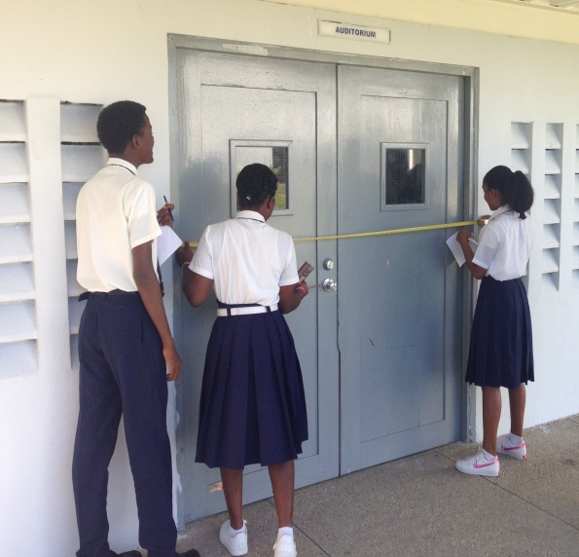
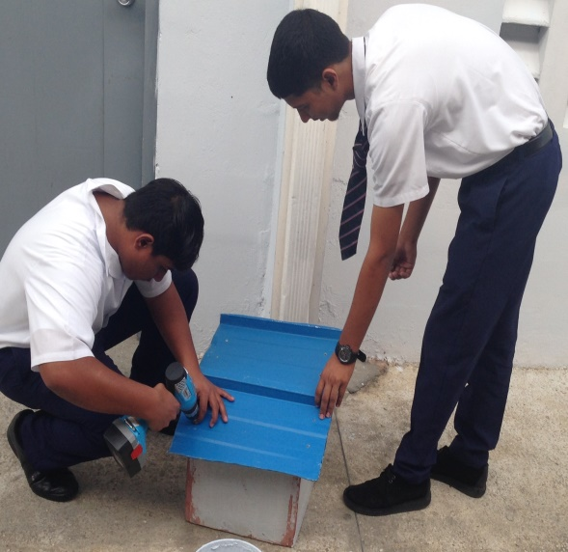
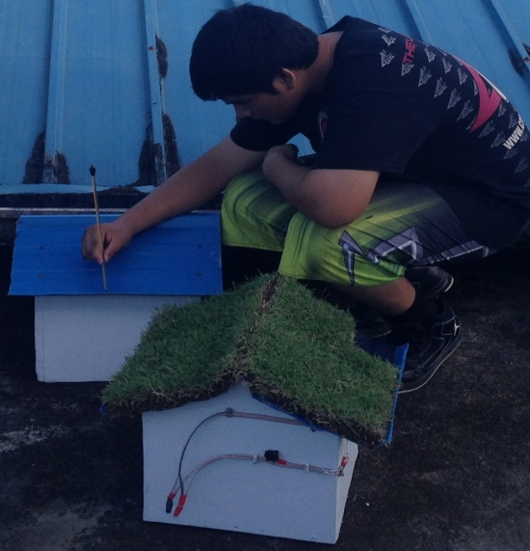
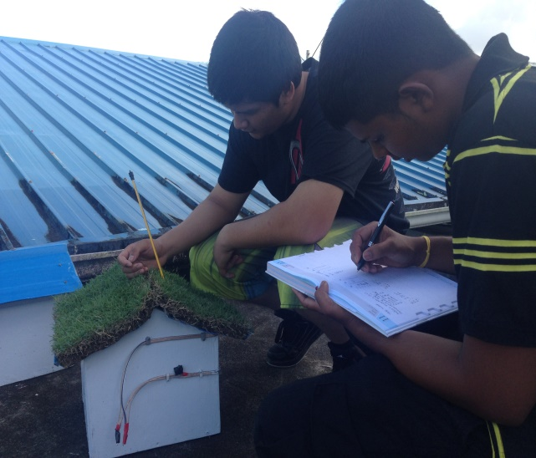
THE CONSTRUCTION PROCESS
The measuring stage
The constructing stage
The two models
Recording temperature values on the two models

Slide 8
RESULTS
TABLE 1 SHOWING A COMPARISON OF TEMPERATURES BETWEEN THE GREEN ROOF AND THE EXISTING ROOF OVER A PERIOD OF ONE WEEK.
DAY | AMBIENT TEMPERATURE / ºC | ROOF TEMPERATURE/ ºC |  | INSIDE TEMPERATURE/ ºC
 |  | GREEN | NORMAL | GREEN | NORMAL
1 | 30 | 24 | 28 | 26 | 29
2 | 31 | 23 | 30 | 25 | 30
3 | 30 | 25 | 31 | 26 | 31
4 | 31 | 27 | 30 | 25 | 29
5 | 28 | 23 | 27 | 24 | 25
6 | 31 | 25 | 30 | 26 | 31
7 | 30 | 26 | 31 | 25 | 29

Slide 9
ANALYSIS OF RESULTS
From the results obtained, it is clearly seen that our “green” modifications had a marked reduction on the temperature of the roof and the inside temperature.
The average reduction in temperature inside the auditorium was on average 4.5ºC cooler and on the roof, 5ºC cooler than average.
On Day 5 when the ambient (outside) temperature was a bit cooler,(due to it being a rainy day), the temperature was recorded as 23ºC for the green roof and the inside temperature as 27ºC for the same model.

Slide 10
DISCUSSION
With the green turf grass blocking the direct sunlight from heating the galvanize roof, the conduction and radiation of the heat was tremendously reduced hence lowering the inside temperature.
This in turn reduced the amount of heat transferred to the enclosed space.
With the help of the solar power extractor fans, it was possible to remove the hot air from the auditorium hence effectively cooling the entire space.

Slide 11
LIMITATIONS
The presence of air ventilation blocks and their effect was assumed to be negligible.
In addition the amount of heat contributed from the concrete walls were also disregard as only a short period of time these walls are fully exposed to the direct sunlight and as such their effect were considered negligible.
The initial start up cost may be expensive but it is still significantly less than installing and maintaining eight (8) 60 000 BTU air condition units.

Slide 12
FUTURE MODIFICATIONS
To cover most of the outside walls with plants in order to simulate the same cooling effect as the green roof.
In addition PVC pipes filled with water could also be installed along the side of the walls. With water having a very high heat capacity, most of the heat will be absorbed and contained in these “heat sinks” rather than be transferred to the walls and thus into the auditorium.
With respect to the recording of the temperature,if we aquire a thermal camera, we will be able to get images of areas when the temperature is the highest and which areas are the lowest and thus make further modifications to our model.

