Slide 1
Introducing
ERVICES Go Global
The Roadmap for Exporting Services
An initiative of the
Caribbean Network of Service Coalitions

Slide 2
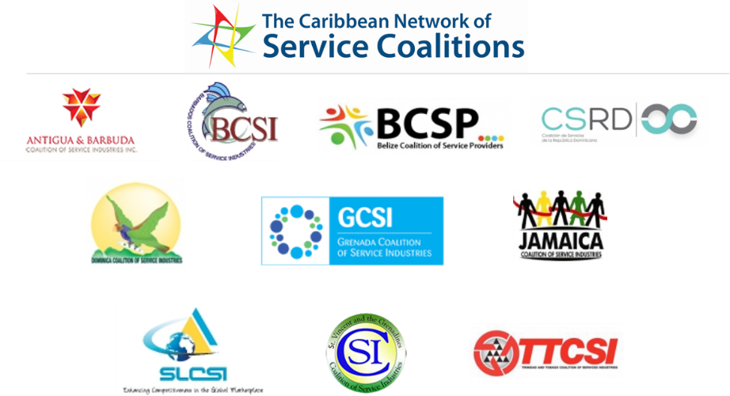
This programme has been made possible through the generous support of the Caribbean Export Development Agency
and the Deutsche Gesellschaft für Internationale Zusammenarbeit (GIZ).
ERVICES Go Global
The Roadmap for Exporting Services
SERVICES Go Global is delivered in the Caribbean by the Coalitions of Service Industries (CSIs) who are members of the Caribbean Network of Service Coalitions (CNSC).
This programme was developed by
Global Links Network Canada and associates. Materials may not be copied or reproduced without express permission.
Coalitions of Service Industries and authorized trainers of the programme may reproduce according to terms and conditions specified in the trainer agreements.
© Global Links Network
Notes:
Notes:
Take a few moments to present this slide explaining the CNSC- the network of CSIs - the only region in the world to be so well represented in trade in services.
Thanks to the continued, generous support of GIZ and the Caribbean Export Development Agency, this project has been made possible.
Note that these materials are copyrighted – only the Coalitions and select trainers are authorized to use.

Slide 3
Services constitute two-thirds of the world’s economy
and are the fastest growing component of world trade.
They are core drivers of economic growth, employment
and development in every part of the world.

Slide 4
A New Regional Programme
PARTICIPATING COUNTRIES: Antigua & Barbuda, Barbados, Belize, Dominica, Dominican Republic, Grenada, Jamaica, Saint Lucia, St. Vincent & the Grenadines, Trinidad & Tobago
PRIORITY SECTORS: Business and Professional, Construction-related, Creative, Education, Health and Wellness, Information & Communication Technologies, Tourism-related

Slide 5
The Caribbean Network of Service Coalitions
In December 2010, the Caribbean Network of Service Coalitions (CNSC) was established. The CSNC is a network of independent coalitions, collaborating on the development of the regional services sector.
The network’s current objectives include:
To raise awareness
To develop export promotion programmes
To lobby
To support institutional strengthening

Slide 6
Regional Support
Many agencies have extended support to the regional services sector development efforts:
National Governments
CARICOM Secretariat
Caribbean Export Development Agency
European Development Fund
Deutsche Gesellschaft für Internationale Zusammenarbeit (GIZ)
Commonwealth Secretariat
Caribbean Development Bank (CARTFUND)

Slide 7
The Role of a CSI
A service coalition is an organization of stakeholders related to the services sector who may have diverse sub-sectoral interests,
but who share common industry-wide objectives
– namely the development of the service industry.
Ultimately, the role of a Coalition of Service Industries is
to enhance the international competitiveness
of their national services sector and increase exports.

Slide 8
CSI Strategies and Services
Strategies
Raising Awareness
Capacity Building
Advocacy
Export Promotion
Services
Newsletters
Networking Events
Training
Advocacy Support
Market Research
Trade Missions
Policy Development
Association Building & Strengthening
…and many more

Slide 9
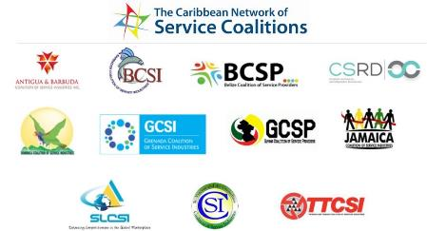
Service Coalitions create an enabling environment for the export of services
For Service Providers
Information
Education
Networking
Opportunities
Support
For Sector Associations
Enhanced member services
Voice for the sector
Sector research & development
For Government
Focal point
Data collection
Information dissemination
Policy development
Export promotion
Notes:
Service Coalitions are ideally suited to deliver the new training program. As focal points for trade in services in each country, they create an enabling environment for trade in services.

Slide 10
Many new exporters jump into potential markets too quickly and unprepared - and fail. It is important to do the necessary preparatory work or you risk losing the investment of your time and resources.
Notes:
Notes:

Slide 11
What is a Service Export?
1.1.1 What is a Service Export?
Notes:
Notes:
Set the stage early for making this an interactive course. Ask this question of the participants. “What is a Service Export?” Do they know the definition? Can they explain it? (answer on the next page)

Slide 12
1.1.1 What is a Service Export?
Companies become service exporters,
if they are paid for their services
by someone from another country,
regardless of where the service is provided
or where the payment is made.
Notes:
Notes:
There are many ways of explaining a service export.
In the context of this training programme, this is the clearest and most technically-correct way to explain it.

Slide 13
Services Classification
1.1.1 What is a Service Export?
The GATT Services Sectoral Classification List, known as W/120, is a services classification system that has been used to structure commitments of members of the World Trade Organization in negotiations. Categories include:
Business services
Communication services
Construction and related engineering services
Distribution services
Educational services
Financial services
Health related and other social services
Tourism and travel related services
Recreational, cultural and sporting services
Transport services
Other services
Within these categories, there are actually over 140 actual types of exportable services.
Notes:
Notes:
Because there are so many different types of services, classification systems have been used to facilitate trade negotiations and the gathering of statistics.
The W/120 is the classification system used by the WTO and often used in other trade negotiations.

Slide 14
Examples of Services Exported
1.1.1 What is a Service Export?
Business and Professional Services
Accounting
Advertising
Courier
Education and Training
Financial
Legal
Management Consulting
Market Research
Marketing
Printing
Real Estate
Security
Wholesaling/Retailing
Environment
Environmental Assessment
Environmental clean-up
Renewable energy
Health-related
Diagnostic and Telemedicine
Health and Wellness Tourism
Medical Transcription
ICT and IT Enabled
Business process outsourcing
E-commerce
Graphic Design
Internet service provision
Construction
Architecture
Design
Engineering
Trades
Urban Planning
Creative
Fashion and Design
Film and Video
Music and Performing Arts
Visual Arts
Notes:
Notes:
Services Go Global (SGG) is intended for service providers with ‘exportable’ services.
In the Caribbean, priority sectors include: Business Services, Construction-related, ICT and IT enabled, Culture, Environment and Health-related sectors.
SGG training sessions will include representatives from a variety of sectors, which may result in the development of cross-sector clusters and the development of consortia.
Cross-sector clusters provide efficient, one-stop shopping for consumers.
SGG will become a launch pad for future initiatives – incubation units, integration into global value chains, etc.

Slide 15
1.1.1 What is a Service Export?
Are you currently exporting your services???
Notes:
Notes:
Ask the participants if they are currently exporting services?
If so, for how long and what kind of services to what markets.
(The answers should help trainers put the group into perspective and help with focusing the content of training materials)

Slide 16
Delivering by the 4 Modes
1.1.1 What is a Service Export?
Mode 1: Cross Border Supply
Cross Border Supply is when a service is provided from a supplier in one country, to a consumer in another and only the service crosses the border. This is most often done using electronic delivery, namely the Internet.
Mode 3: Commercial Presence
Commercial Presence is when the supplier of a service establishes a presence in another country by setting up a subsidiary or branch, for example. The consumer then purchases the service from the subsidiary in their own country.
Mode 2: Consumption Abroad
Consumption Abroad is when a service is supplied in the country of the supplier, but to a consumer from another country (i.e. the consumer goes abroad).
Mode 4: Movement of Natural Persons
Movement of Natural Persons is when a supplier of a service temporarily visits the country of a consumer to offer a service (i.e. the service provider goes abroad).
Notes:
Notes:
The WTO lists 4 modes, or ways, of delivering services.
Present each mode, pointing to each image which illustrates whether the service itself, the buyer or the seller are crossing borders.
After presenting each of the 4 modes, ask the participants who is currently, or plans to export and via which mode?

Slide 17
Constraints Affecting Service Firms
Management
Service Offerings
Financing
Marketing
Primarily MSMEs (usually 1-10 employees)
No clear objectives
Short-term thinking
Strengths/weaknesses
No business plans
Insular thinking
Quality standards
Differentiation
Branding
Intellectual property
Cost of travel
Cash flow position
Getting paid
Difficulty in accessing financing (no assets)
Ability to invest
How to market “invisibles”
Rushing to market unprepared
Technical skills but limited marketing skills
Access to market information and intelligence
Knowledge of market access requirements
Insufficient attention to marketing
Limited use of online strategies
Competitiveness
Strategic networking
Difficulty in establishing credibility
Knowledge re establishing partnerships
Weak proposal writing skills
Limited knowledge of pricing strategies
Limited use of ready-made templates
Mindset
Human Resources
Confidence
Complacency
Lack of motivation
No sense of urgency
Prioritization
Time management
Recognition of professional credentials
Productivity
Mobility of personnel
Weak project management skills
However, exporting services can be easy for companies who are prepared!
Notes:
Notes:
There are many constraints affecting a services firms competitiveness.
SERVICES Go Global is structured to addresses these concerns through a systematic process, according to the firm’s level of development.

Slide 18
SERVICES Go Global is an export-readiness programme that leads
to the development of a company’s Export Plan.
The Roadmap to Exporting Your Services!
Stage 4
Entering the
Market
Stage 3
Developing a
Marketing Strategy
Stage 2
Conducting
Market Research
▪ 4 stages ▪ 2 modules ▪ 100 competencies
▪ Qualified, experienced trainers
▪ PowerPoints ▪ Speaker Notes ▪ Workbooks
▪ Exercises ▪ Tools ▪ Templates
▪ ▪ ▪ Your Export Plan ▪ ▪ ▪
Stage 1
Preparing
Your Business

Slide 19
Roadmap for Exporting Services
The 4 Stages of Export Preparation
Stage 1
Stage 2
Stage 3
Stage 4
Preparing
Your Business
Conducting
Market Research
Developing a
Marketing Strategy
Entering the
Market
1.1
Understanding
Trade in Services
2.1
Researching
Markets
3.1
Starting with a Marketing Plan
4.1
Market Entry
Options
1.2
Assessing
Export-readiness
2.2
Researching
Sectors
3.2
Developing an Online Strategy
4.2
Travelling
to the Market
1.3
Developing your
Export Plan
2.3
Gathering
Market Intelligence
3.3
Winning Business
4.3
Financing
and Contracting
Export Plan
Notes:
Notes:
Present the Roadmap, indicating that the training programme has been structured according to the 4 stages of export preparation.
The stages are designed for the participants to learn about the exporting process and acquire skills each step of the way.
Present each stage and the modules under each stage and point out that for each module, the Export Plan should continually be updated.
Also mention that while the topics have been organized in this way for the purposes of training. In actual practice, exporters would likely be moving around from one to the other in a less structured way. In other words, don’t wait until all stages are perfect. Many companies learn about exporting when they have received an enquiry and need to figure out how to respond.

Slide 20
For all Service Sector Stakeholders
SME Service Providers
Interested in exporting
Enhance export knowledge, skills, capabilities
Work towards becoming export-ready
Intermediaries
Management consultants
Accountants
Financial institutions
Educational institutions
Marketing firms
Research firms
Service Providers
Intermediaries
BSOs
Business Support Organizations
Sector Associations
Chambers of Commerce
Other BSOs
Government Agencies
Trade Promotion Organizations
Line ministries
Regional agencies
Government
Notes:
SME Service Providers – to work towards export-readiness
Intermediaries – to better service their clients
BSOs – to provide value for membership, to focus on sector growth
Government agencies – to increase understanding of the business aspect of trade in services and to better align programmes and support services

Slide 21
Training Methodology
Instructor-led training
PowerPoint presentations
Active learning techniques, tools, templates
Group and individual exercises, role playing
Content is sector-generic, however sector-specific examples are used
Competency-based learning
over 100 competencies
Exercises – some in class, some in-between sessions
Export Plan
Detailed exercises lead to development of Export Plan
Notes:
SERVICES Go Global is a competency-based system with 4 stages, 12 modules and over 100 specific competencies.
Instructor-led training using sound adult pedagogical learning theories in combination with presentations, active learning techniques, tools, templates, exercises.
Given the diverse characteristics of the service sector, the training is sector-generic, however sector-specific examples are used.
Group exercises, role playing and case studies are introduced, with major emphasis on the participating company applying the knowledge directly to their own company.
Course content (approx 30-40% of existing GLN content) has been previously used for delivery in over 40 countries (including the Caribbean) on behalf of WTO/UNCTAD ITC, Government of Canada, TFO Canada, FITT and others.

Slide 22
1
Preparing
Your Company
tage
1.1 Understanding Trade in Services
1.1.1 What is a Service Export?
1.1.2 Global Trade in Services
1.1.3 Small Business Perspective
1.1.4 Enabling Environment
1. 2 Assessing Your Export-Readiness
1.2.1 What is Export-Readiness?
1.2.2 Assessing Resource Requirements
1.2.3 Conducting a SWOT Analysis
1.2.4 Evaluating Export Potential
1.3 Developing your Export Plan
1.3.1 Why have an Export Plan?
1.3.2 Components of the Export Plan
1.3.3 Best Practices
1.3.4 Export Plan Template
Notes:
Notes:
Briefly introduce these topics

Slide 23
2
Conducting
Market Research
tage
2.1 Researching Markets
2.1.1 What is Market Research?
2.1.2 Market Research Objectives
2.1.3 Understanding Market Types
2.1.4 PESTE Analysis
2.1.5 Sources of Market Information
2.2 Researching Sectors
2.2.1 Business and Professional
2.2.2 Construction-related
2.2.3 Creative
2.2.4 Health-related
2.2.5 ICT and ICT Enabled
2.3 Gathering Market Intelligence
2.3.1 What is Market Intelligence?
2.3.2 Types of Market Intelligence
2.3.3 Understanding Customer Needs
2.3.4 Finding Opportunities
2.3.5 Competitive Analysis
2.3.6 Selecting Target Markets
Notes:
Notes:
Stage 2: Conducting Market Research Conducting market research is an important step in preparing to export. Gathering market information and intelligence will help you to make the right decisions about which markets to target and how to approach them.
This will ultimately save you time and money and increase your chances for success.
Stage 2 is organized into 3 modules – Researching Markets, Researching Sectors and Gathering Market Intelligence.

Slide 24
3
Developing a Marketing Strategy
tage
3.1 Starting with a Marketing Plan
3.1.1 Strategic Elements
3.1.2 Value Proposition
3.1.3 Marketing Mix
3.1.4 Branding and Market Positioning
3.1.5 Building Networks
3.1.6 Establishing Profile and Credibility
3.1.7 Relationship Marketing
3.1.8 Promotional Materials
3.2 Developing an Online Strategy
3.2.1 Establishing an Online Presence
3.2.2 Developing an Effective Website
3.2.3 Social Media Marketing
3.2.4 Cloud-Based Productivity Tools
3.3 Winning Business
3.3.1 Customizing Solutions
3.3.2 Costing and Pricing
3.3.3 Proposal Writing
3.3.4 Working with Government
3.3.5 Pursuing IFI Opportunities
Notes:
Notes:
Stage 3: Developing a Marketing Strategy
This topic is key. The better your export marketing strategy, the better your chances for success. Many exporters fail, because they do not develop any kind of marketing strategy.
Here is an overview of the steps to take in formulating a successful, in-depth marketing strategy, including practical tips that will be useful to new (and existing) exporters.
This critical topic is organized into the following three modules: 1. Starting with a Marketing Plan; 2. Developing an Online Strategy; and 3. Winning Business.

Slide 25
4
Entering
the Market
tage
4.1 Market Entry Options
4.1.1 Market Access
4.1.2 Strategic Alliances
4.1.3 Delivering by the 4 Modes
4.2 Travelling to the Market
4.2.1 Preparing for a Market Visit
4.2.2 Participating in a Trade Mission
4.2.3 Cultural Considerations
4. 3 Financing and Contracting
4.3.1 Planning Your Financing
4.3.2 Financing for Export Market Development
4.3.3 Getting Paid
4.3.4 Contracting and Legal Aspects
Notes:
Notes:
A market entry strategy is how you plan to deliver services in a new target market. Clearly, a critical element of your export plan!
This section comprises of 3 modules – Market Access, Strategic Alliances, and Delivering Services by the 4 Modes of Supply.

Slide 26
ERVICES Go Global
The Roadmap for Exporting Services
An initiative of the
Caribbean Network of Service Coalitions

