Slide 1

TTCSI
VENTURE CAPITAL
WORKSHOP
THE ART OF BUSINESS:
UNDERSTANDING VENTURE CAPITAL
Jason Julien, CFA
August 22, 2014

Slide 2

What fuels business Growth?

Slide 3
Capital
Profits
Cash Flow

Slide 4

Capital is the seed
Growth needs capital
Patient capital

Slide 5
What is venture capital?
... Also known as Private Equity…

Slide 6
What is venture capital?
Money provided by investors to startup firms and small businesses with perceived long-term growth potential.
This is a very important source of funding for startups that do not have access to capital markets.
It typically entails high risk for the investor, but it has the potential for above-average returns

Slide 7
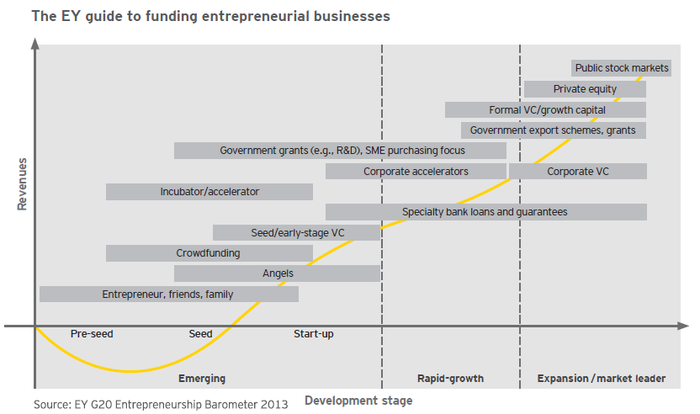
Traditional Funding Lifecycle

Slide 8
Questions VC Asks
Would this business grow?
Would it provide an superior Return given the Risk?
When will I exit?
How will I exit?

Slide 9
How is the capital provided?
Equity:
- Ordinary Shares
Mezzanine Finance:
- Subordinated Debt
- Preference Shares

Slide 10
A brief history…
15 VC/PE Funds
Increased VC/PE activity and rising number of Funds
1997-2007
VC/PE activity takes root
1980’s
Steep decline in VC/PE activity and Fund closures
2008-2012

Slide 11
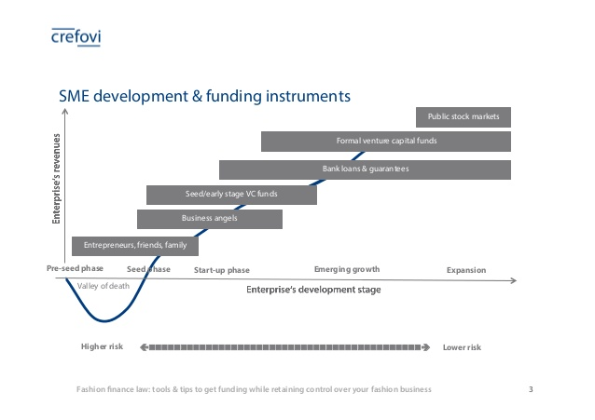
The Role of Bank Financing
Risk profile
Stage of funding
T&T is a Banking market
Challenges with dealing with Banks

Slide 12

Any Questions?

