Slide 1
Corporate Governance in Institutionalizing Project Management’
Narayan Ramtahal
Past President and VP Sponsorship
Project Management Institute Southern Caribbean Chapter
2014 November 06

Slide 3
Contents
Project Management context
Corporate Governance
Project Governance
New Critical PM skill sets
New PM Triple constraints
Drivers of Organisation’s PM success
Next generation PM skills
Project Talent Management
Tiered Structure of PM Seniority
Conclusion

Slide 4
1.0 What is project management
Project management is the application of knowledge, skills and techniques to execute projects effectively and efficiently.
It is a strategic competency for organizations, enabling them to tie project results to business goals
Processes
Initiating / planning / executing / controlling /closing
Knowledge areas
Project Integration Management / Scope / Time / Cost / Quality / HR / Communications / Risk /Procurement / Stakeholder
Project life cycle and phases

Slide 5
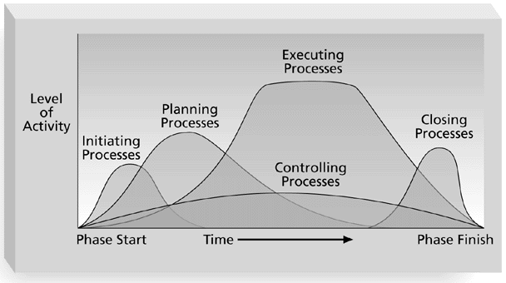
1.2 Overlap of Process Groups in a Phase (PMBOK Guide, 2000, p. 31

Slide 6
1.3 Context of Project Management
Operates in a broad based organizational system
Adheres to Organizational standards
Requires Top Management Commitment

Slide 7
1.4 The Context
Co
Corporate Governance
ProProoject
Project Governance
Project Management

Slide 8
1.5 Corporate governance
Corporate governance encompasses all work done in an organization
Governs the work in traditional line organizations
Governs the work done in temporary organizations, such as projects.
Corporate governance interfaces and overlaps with project management governance
Corporate Governance sets the boundaries for the governance of projects
Increasingly aware of the importance of corporate risk management, sustainable development and ethical practice

Slide 9
1.6 Project Governance
Project governance is the management framework within which project decisions are made.
Project governance is a critical element of any project since while the accountabilities and responsibilities associated with an organization’s business as usual activities are laid down in their organizational governance arrangements, seldom does an equivalent framework exist to govern the development of its capital investments (projects)

Slide 10
2.0 Drivers of Organization’s Project Success
Lessons from high-performing organizations and their approaches to project, program, and portfolio management:
Alignment of project management to organizational strategy
Cultivating project management talent

Slide 11
3.0 Success Criteria: Governance of Project Management
The governance of PM concerns those areas of Corporate Governance that are specifically related to Project Activity. Effective Governance of PM ensures
Organization’s portfolio of projects is aligned to organization’s objectives
Is delivered efficiently
Is sustainable
How the PM Capability of the organisation is achieved and sustained

Slide 12
3.1 Governance of Project vs Governance of Project Management
Portfolio Management
Governance of Project
Governance of Project Management
Centre of Excellence
PMO focus on
Project Delivery

Slide 13
4.0 Next Generation skills in Project Management
Technical Project Management skills
Greatest shortage
Teachable
Strategic and Business Management skills
Teachable
Leadership skills
Search for talent with these skills

Slide 14
4.1 Change in Triple Constraints
Original Triple Constraint | Talent Triangle – Next Generation Skills
Time | Technical
Cost | Leadership
Scope | Strategic and Business Management

Slide 15
5.0 Talent Management Initiatives
Defined career paths and skills requirements
Identification and grooming of top performers by senior management
Regular assessment reviews
Alignment between strategic goals, project portfolios and staff
Stretch assignments that give young project leaders opportunities to extend their skills, knowledge and network
Mentoring and coaching

Slide 16
5.1 Tiered Structure of PM Seniority
1. Associate project manager: Plans, organizes, monitors and leads small teams ,with PMI Certified Associate in Project Management (CAPM)® certification or Project Management Professional (PMP)® preferred.
2. Project manager: Manages all aspects of moderately complex medium- to large-scale projects CAPM® or PMP® credential preferred.
3. Program manager: Oversees and supports programs and processes across the institution.
4. Senior project manager: Manages all aspects of highly complex medium- to large-scale strategic projects that span three or more organizational boundaries. PM P credential required.
5 Project director, directing and managing multiple interrelated implementations, or portfolio manager, managing governance and project management processes, methodologies and tools..

Slide 17
5.2 Implementing a Project Talent Management Program
organizations should
Hold leaders accountable for developing the next generation. “At Fluor we have 600 executives who are our internal talent scouts,” says Fluor’s Mr. Gilkey. “Having a culture where people want to help others succeed can’t be understated.”
Look for passion and confidence as signs of high performers. Although leadership should provide training and new kinds of opportunities, the ideal individuals will pursue education, credentials and experiences on their own, says NASA’s Dr. Hoffman.
Build a support structure that nurtures young talent. Everyone makes mistakes, and when new project managers are put into stretch assignments, it increases their risk of failure. “Make sure they have a network and leadership guidance so they have someone to turn to when they need help,” Mr. Gilkey says.
Educate the organization about the value of project management skills in meeting strategic goals. When companies align their talent development efforts with business results, people pay attention, says MD Anderson Cancer Center’s Ms. Layne.
Plan ahead. It takes years to build a project management talent pipeline, and companies should be consistently developing the right skills in the right regions, says Fluor’s Mr. Brown.

Slide 18
6.0 Conclusion
Organizations must invest time and resources to identify high-potential project and program managers and give them the training and opportunities they need to advance.
Developing top-tier project talent does not happen overnight.
Aligning the best talent with projects and business needs is mission critical to a company’s success and it attracts future professionals by reinforcing the talent brand

Slide 19
References
PMI White Paper on Building High-Performance Project Talent.
PMI’s Pulse of the Profession™ In-Depth Report: Talent Management.
Project Management – Harold Kersner

